Slide 1
NewsFeed
Chris Jacob Bobby

Slide 2
Goals
Mobile application to provide a user with their prefered news from over 70 sources
Machine Learning analysis of each article
Machine learning analysis of trending/top topics
History of articles viewed and user preferences

Slide 3
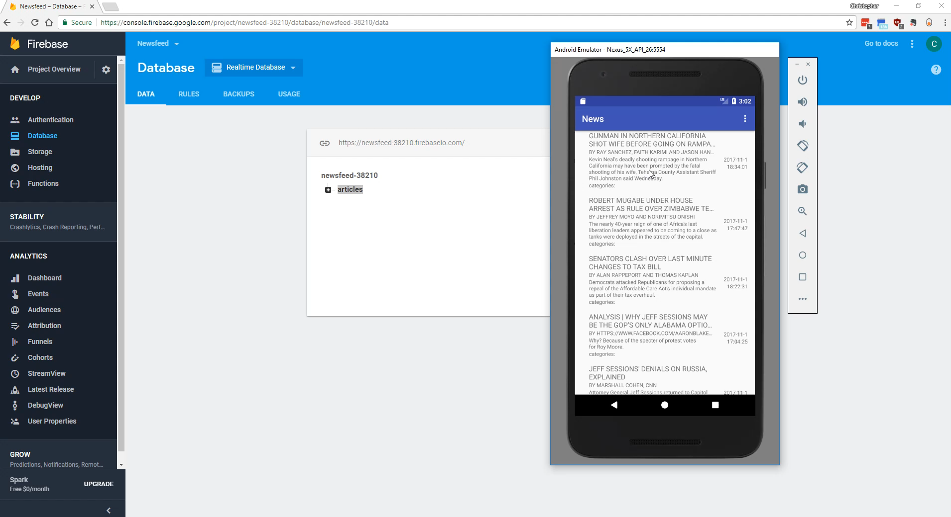
Video Demo

Slide 4
Work done so far
Chris
I did the initial configuration for firebase and researched a more permanent configuration for the API keys, and how to handle multiple queries.
implemented QueryUitl.java functions to query sources
implemented SourceLoader.java, Entity.java and put all the models under model
Robert
Made Navigationview
Set up events for all the events to get data
Jacob
Added authentication to firebase
Created login activity with listeners and methods
Using firebase to use historical info

Slide 5
Difficulties so far
Figuring out the best to use three separate RESTapi calls without impacting performance
Trying to find an efficient way to get data without running a query for each source
Serializing and Desacralizing different json objects

